Slide 1

First and last touch attribution
Learn SQL from Scratch
Janine Jones
February 2019

Slide 2
Table of Contents
Get familiar with CoolTShirts
Campaigns and sources
Pages on the CoolTShirts site
2. What is the user journey?
First touches
Last touches
Purchases
Overall user journey
3. Optimising the campaign Budget

Slide 3
1. Get familiar with CoolTShirts

Slide 4
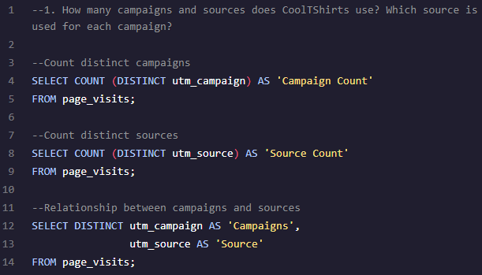
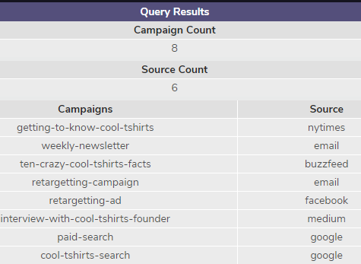
How many campaigns and sources does CoolTShirts use and how are they related?
A source (utm_source) is a touchpoint that drives traffic to a website, for example, facebook, email, buzzfeed. CoolTShirts has 6 sources (nytimes, email, buzzfeed, facebook, medium, google)
A campaign (utm_campaign) is a specific piece of communication that is designed to generate a response. Examples could be an retargeting ad on facebook, or a paid search on google. Each source can have multiple campaigns associated with it, for example weekly-newsletter and retargeting-campaigns are both associated with the email source. CoolTShirts has 8 campaigns (shown below with their sources)

Slide 5
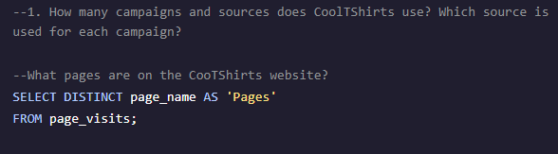
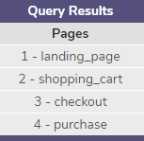
What pages are on the CoolTShirts website?
There are four distinct pages on the CoolTShirts website that the links in campaigns directed users to.
Landing page
Shopping cart
Checkout
Purchase

Slide 6
2. What is the user journey?

Slide 7
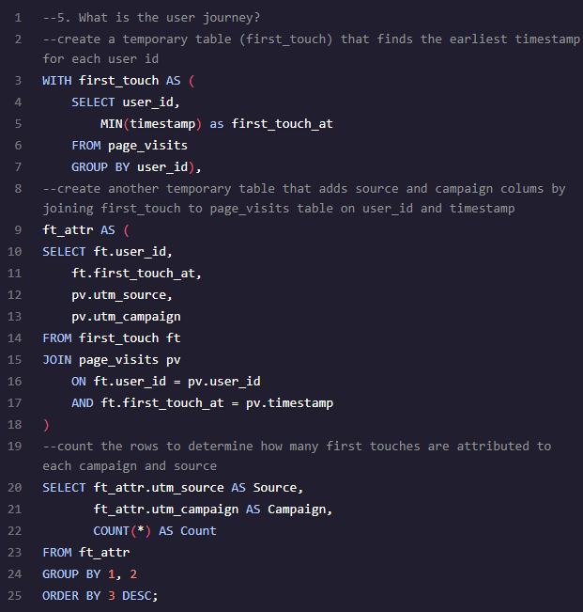
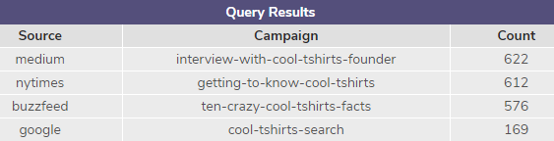
What is the user journey – first touches by campaign?
The first touch for each user can be found by identifying which campaign had the earliest timestamp (i.e. the first campaign that they interacted with). In total, there were 1,979 visitors.
Four campaigns were responsible for all the first touches, and each of these had a different source. It seems that the brand’s articles in various news sources are a very valuable way of attracting users to the site, as these were the top 3 campaigns for first touch.

Slide 8
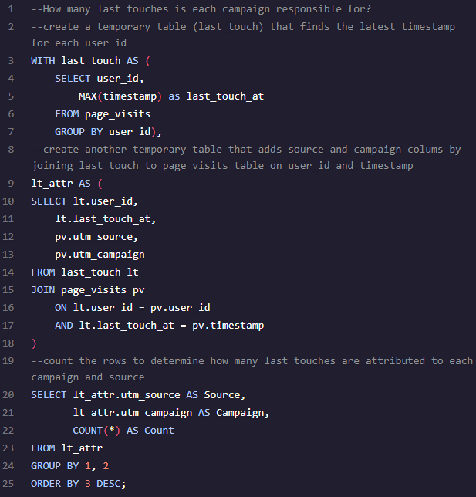
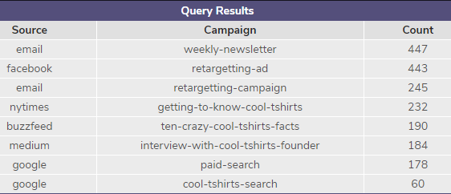
What is the user journey – last touches by campaign?
The last touch for each user can be found by identifying which campaign had the latest timestamp (the last campaign a user interacted with)
All 8 campaigns were responsible for some last touches, but the most successful sources were email (weekly newsletter and retargeting-campaign) and a retargeting-ad on facebook. This suggests that when a user first visits the site, the company collects email subscriptions. I would also assume that information about the pages that a user visits is collected to make sure that both the email and facebook retargeting campaigns show relevant information (for example, images of products that the user viewed).

Slide 9
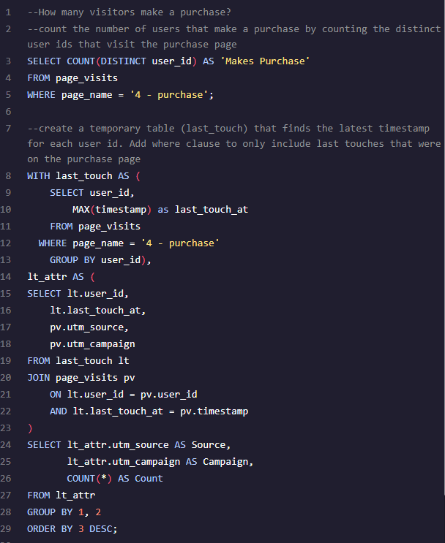
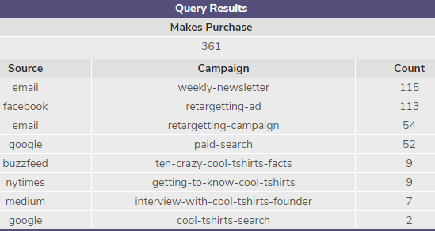
What is the user journey – how many visitors purchase?
By finding cases where the max timestamp was on the purchase page, we can identify which campaigns and sources were responsible for users making a purchase. There were 361 purchasers (CR of 361/1979=18.2%)
4 campaigns accounted for 93% of all the purchases.

Slide 10
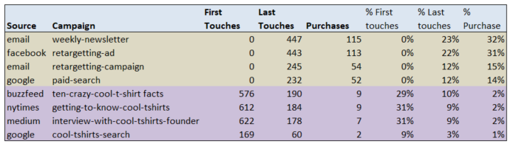
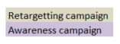
What is the user journey – from first touch to purchase?
All users come to site through 4 ‘awareness’ campaigns. Of these users, 31% do not return, however, 7% make a purchase on this first visit.
The remaining 69% of users are re-engaged by 4 ‘retargeting’ campaigns. Of these users, 24.4% of them go on to make a purchase. 93% of all purchases are therefore generated by these retargeting campaigns.
When a user visits the site, they have the option of subscribing to an email list, and as a source, email is responsible for 35% of last touches and 47% of all purchases.
Data is also collected about the pages/products a user visits and used to serve relevant retargeting ads on facebook. The retargeting-ad campaign is responsible for 22% of all last touches and 31% of all purchases.

Slide 11
3. Optimise the campaign budget

Slide 12
Which five campaigns should Cool Tshirts invest in?
Healthy upper funnel metrics are very important, so I would suggest investing in the 3 article awareness campaigns:
Ten-crazy-cool-shirt-facts, getting-to-know-cool-tshirts and interview-with-cool-tshirts-founder.
By investing in these, and expanding their reach, we can increase the number of visitors to site. We would then expect that 70% of these visitors would re-engage through another campaign.
Email is a low cost channel in terms of campaign delivery, but I would suggest adding additional sign up locations on site to increase the size of the subscriber base. I would not invest in the weekly newsletter, as it is already a successful campaign, but I would suggest further investment in the retargeting-campaign. Investing in new technologies such as smart recommendations algorithms could further improve the visit and conversion rate from this campaign.
I would also choose to invest in the retargetting-ad. This is currently only run on facebook, but with more investment this could also run on other sites. We can see that visitors of Cool Tshirts use news sites such as buzzfeed, nytimes and medium, so additional ads could be placed on sites such as this.

Slide 13
/*
Here's the first-touch query, in case you need it
*/
WITH first_touch AS (
SELECT user_id,
MIN(timestamp) as first_touch_at
FROM page_visits
GROUP BY user_id)
SELECT ft.user_id,
ft.first_touch_at,
pv.utm_source,
pv.utm_campaign
FROM first_touch ft
JOIN page_visits pv
ON ft.user_id = pv.user_id
AND ft.first_touch_at = pv.timestamp;

Slide 14
--1. How many campaigns and sources does CoolTShirts use? Which source is used for each campaign?
--Count distinct campaigns
SELECT COUNT (DISTINCT utm_campaign) AS 'Campaign_count'
FROM page_visits;
--Count distinct sources
SELECT COUNT (DISTINCT utm_source) AS 'Source_count'
FROM page_visits;
--Relationship between campaigns and sources
SELECT DISTINCT utm_campaign AS 'Campaigns',
utm_source AS 'Source'
FROM page_visits;

Slide 15
--How many first touches is each campaign responsible for?
--create a temporary table (first_touch) that finds the earliest timestamp for each user id
WITH first_touch AS (
SELECT user_id,
MIN(timestamp) as first_touch_at
FROM page_visits
GROUP BY user_id),
--create another temporary table that adds source and campaign colums by joining first_touch to page_visits table on user_id and timestamp
lt_attr AS (
SELECT ft.user_id,
ft.first_touch_at,
pv.utm_source,
pv.utm_campaign
FROM first_touch ft
JOIN page_visits pv
ON ft.user_id = pv.user_id
AND ft.first_touch_at = pv.timestamp
)
--count the rows to determine how many last touches are attributed to each campaign and source
SELECT ft_attr.utm_source AS Source,
ft_attr.utm_campaign AS Campaign,
COUNT(*) AS Count
FROM ft_attr
GROUP BY 1, 2
ORDER BY 3 DESC;

Slide 16
--How many last touches is each campaign responsible for?
--create a temporary table (last_touch) that finds the latest timestamp for each user id
WITH last_touch AS (
SELECT user_id,
MAX(timestamp) as last_touch_at
FROM page_visits
GROUP BY user_id),
--create another temporary table that adds source and campaign colums by joining last_touch to page_visits table on user_id and timestamp
lt_attr AS (
SELECT lt.user_id,
lt.last_touch_at,
pv.utm_source,
pv.utm_campaign
FROM last_touch lt
JOIN page_visits pv
ON lt.user_id = pv.user_id
AND lt.last_touch_at = pv.timestamp
)
--count the rows to determine how many last touches are attributed to each campaign and source
SELECT lt_attr.utm_source AS Source,
lt_attr.utm_campaign AS Campaign,
COUNT(*) AS Count
FROM lt_attr
GROUP BY 1, 2
ORDER BY 3 DESC;

